Slide 1
Notes:
Surlodas, relative sebesseg, setup javaslat

Slide 2
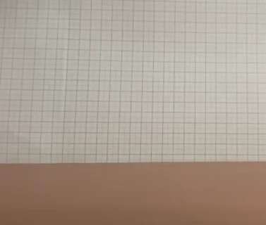
The Problem
A spherical ball dropped onto a hard surface will never rebound to the release height, even if it has an initial spin. A capsule-shaped object (i.e. Tic Tac mint) on the other hand may exceed the initial height. Investigate this phenomenon.
Notes:
Forgas es nem forgas kozti kulonbseg capsule eseten

Slide 3
Qualitative explanation – Ball

Slide 4



Qualitative explanation – Ball
$$F_{Normal}$$
$$a$$
$$F_{Friction}$$

Slide 5
Qualitative explanation – Ball

Slide 6
Qualitative explanation – Capsule

Slide 7





Qualitative explanation – Capsule
$$a$$
$$F_{Normal}>F_{Normal,ball}$$
$$v_{impact}>v_{capsule}$$
$$F_{Friction,trans}$$
$$F_{Friction,rot}$$

Slide 8


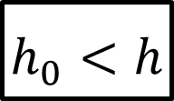
Qualitative explanation – Capsule
$$h$$
$$h_{0}$$
$$h_{0}<h$$

Slide 9
Optimal setup
Same initial starting conditions
Easy parameter variation

Slide 10
Optimal setup
Same initial starting conditions
Easy parameter variation

Slide 11
Optimal setup
Same initial starting conditions
Easy parameter variation

Slide 12
Optimal setup
Same initial starting conditions
Easy parameter variation

Slide 13
Optimal setup
Same initial starting conditions
Easy parameter variation

Slide 14

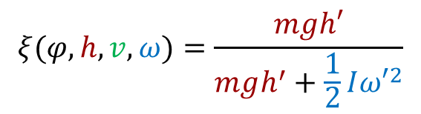
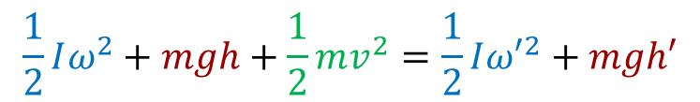
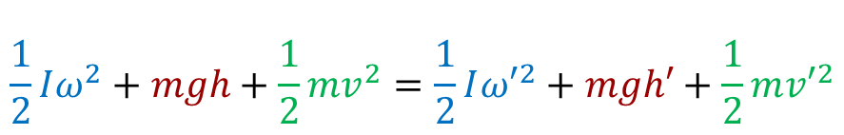
Quantitative theory – Conservation of energy
Conservation of energy
  Assumption: no loss of energy from the impact
  Energies: rotational, potential, kinetic
  $ξ:$ ratio of potential energy to the total energy
  $φ:$ Impact angle with the ground
  Most amount of energy to be converted to potential energy: $ξ≈1,ω′≈0$
$$\frac{1}{2}Iω^{2}+mgh+\frac{1}{2}mv^{2}=\frac{1}{2}I{ω′}^{2}+mgh′+\frac{1}{2}m{v′}^{2}$$
$$\frac{1}{2}Iω^{2}+mgh+\frac{1}{2}mv^{2}=\frac{1}{2}I{ω′}^{2}+mgh′$$
$$ξ(φ,h,v,ω)=\frac{mgh′}{mgh^{′}+\frac{1}{2}I{ω′}^{2}}$$
Notes:
Xi fuggveny kihangsulyozasa, hogy a masodik tagbol jon

Slide 15
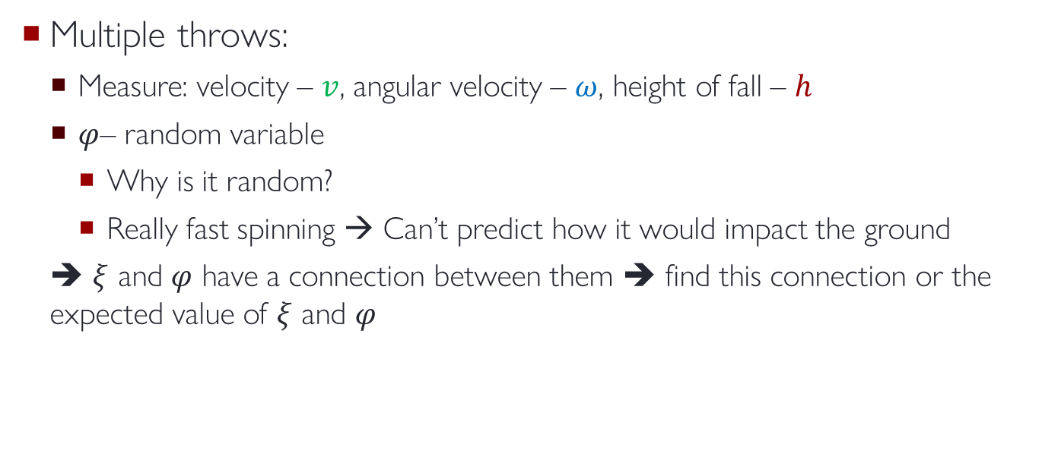

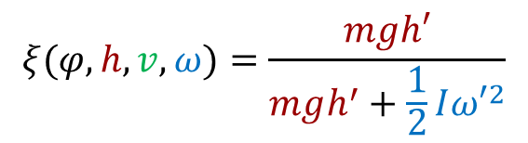
Quantitative theory – Xi function
$$ξ(φ,h,v,ω)=\frac{mgh′}{mgh^{′}+\frac{1}{2}I{ω′}^{2}}$$
$$mgh^{′}=ξ\left(φ,h,v,ω\right) E_{total}$$
Multiple throws:
  Measure: velocity – $v$, angular velocity – $ω$, height of fall – $h$
  $φ$– random variable
    Why is it random?
    Really fast spinning → Can’t predict how it would impact the ground
  ➔ $ξ$ and $φ$ have a connection between them ➔ find this connection or the expected value of $ξ$ and $φ$
Notes:
Par phi erteknel mi lehet, 0 90 45 fok

Slide 16

Solving the problem – basic level
Build a setup where you can throw the capsule the same way every time
Measure lots of different parameters → maximum value of $ξ$ at each parameter
→ Maximal achieved height difference before and after the bounce

Slide 17

Solving the problem – advanced level
Try to find the probability density function of $φ$ at different $\left(h,v,ω\right)$ parameters
$ξ\left(φ,h,v,ω\right)$ find the expected value at fixed $h,v,ω$
Include the loss of energy at the rebound
Find the best parameters to get the highest jump

Slide 18
Thank you for your attention
Notes:
Surlodas, relative sebesseg, setup javaslat

